Slide 1

The Story / Business
Justice League
Budget - 300M
Opening Weekend Estimation - 110M-120M. Actual - 93M
Domestic - 229M
Worldwide - 657M

Slide 2
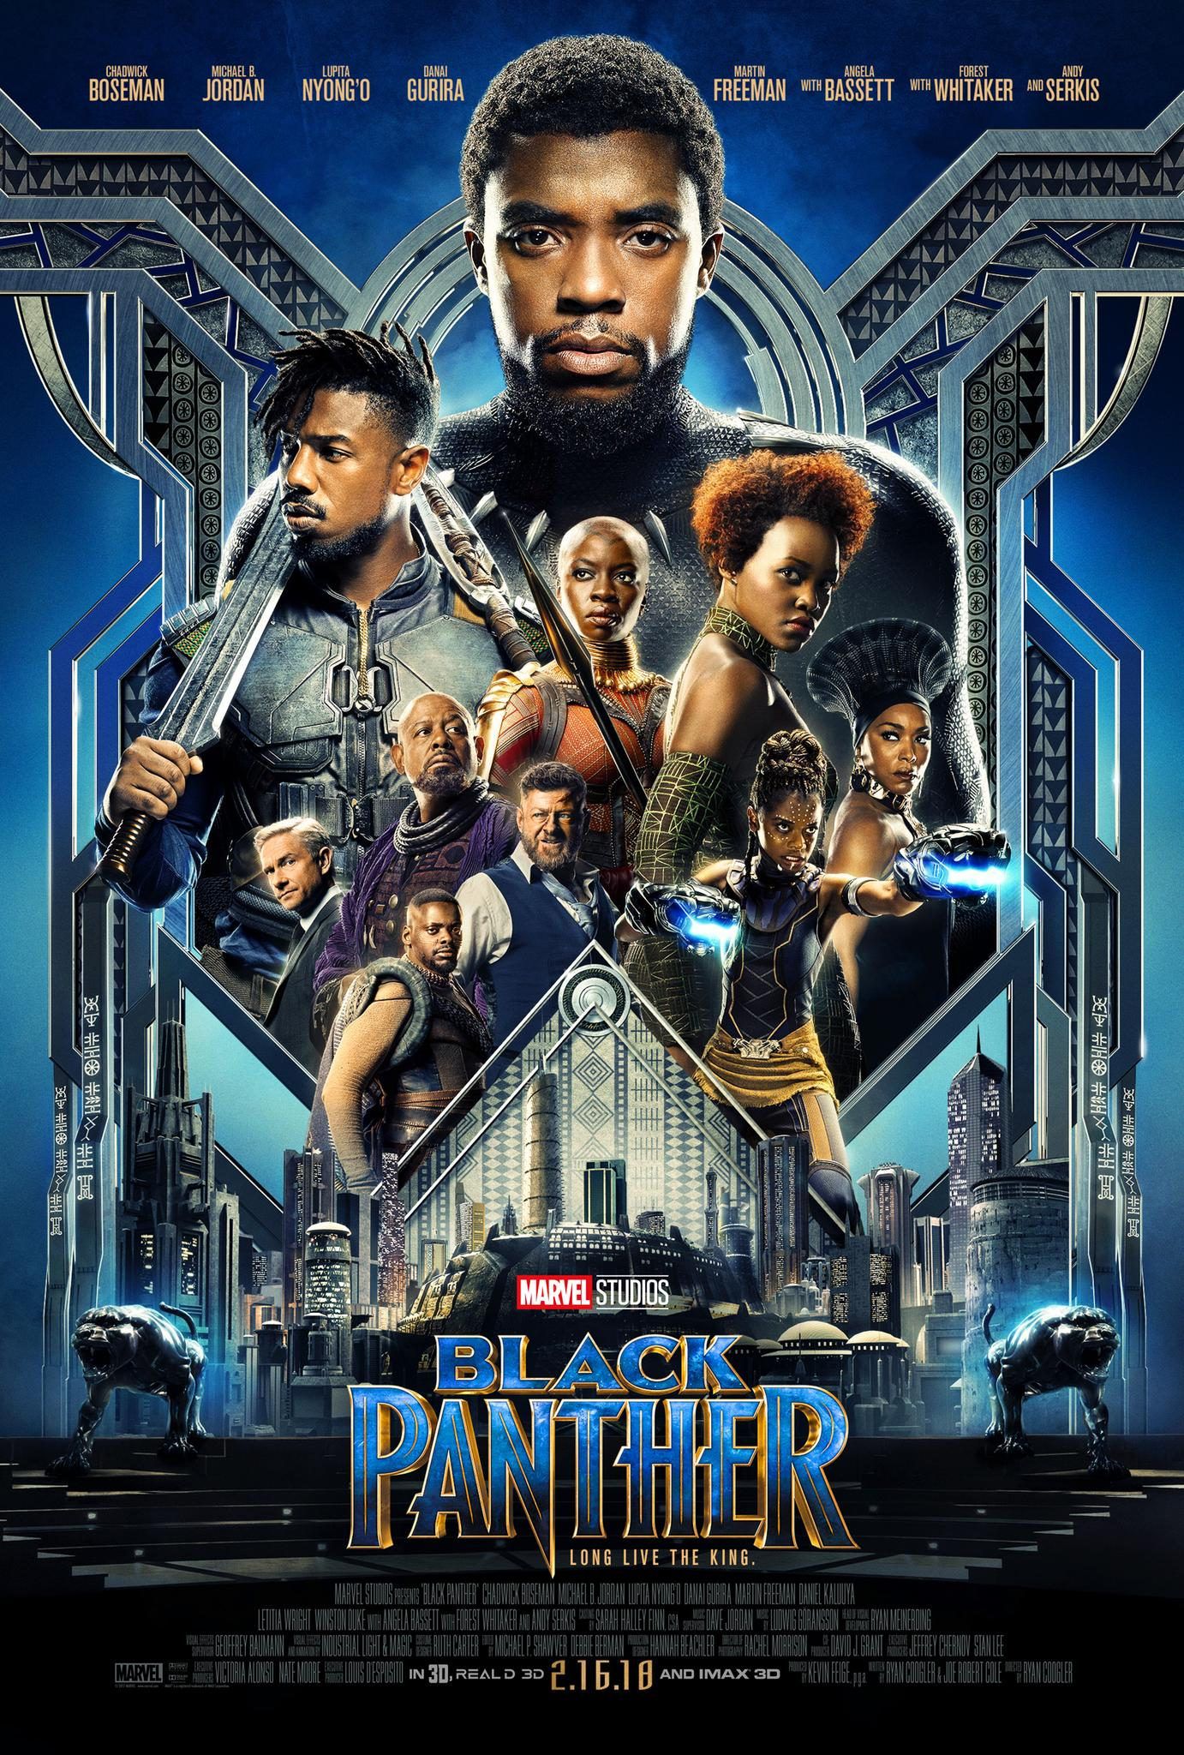
The Story / Business
Black Patnehr
Budget - 200M
Opening Weekend Estimation - 120M. Actual - 202M
Domestic - 700M
Worldwide - 1.34B

